Slide 1
PCA sketch of the proof
CSCI 347
Adiesha Liyanage

Slide 2
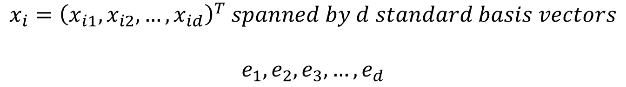
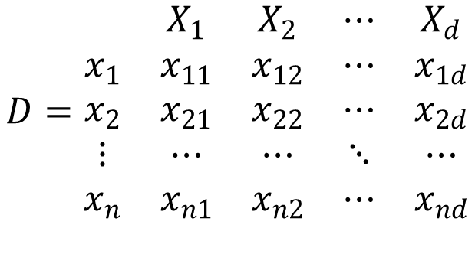

Let the data D consist of n points over d attributes, i.e., it is an n × d matrix, given as
$$D=\begin{matrix} & X_{1} & X_{2} & ⋯ & X_{d} \\ x_{1} & x_{11} & x_{12} & ⋯ & x_{1d} \\ x_{2} & x_{21} & x_{22} & ⋯ & x_{2d} \\ ⋮ & ⋯ & ⋯ & ⋱ & ⋯ \\ x_{n} & x_{n1} & x_{n2} & ⋯ & x_{nd}\end{matrix}$$
$$x_{i}={\left(x_{i1},x_{i2},…, x_{id}\right)}^{T} spanned by d standard basis vectors$$
$$e_{1},e_{2},e_{3},…, e_{d}$$
Standard basis vectors are orthonormal.
$$e_{i}^{T}e_{j}=0 and \left\|e_{i}\right\|=1$$

Slide 3
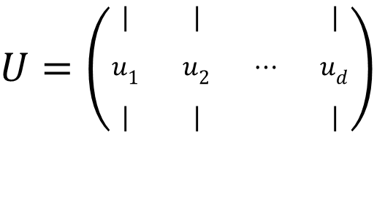
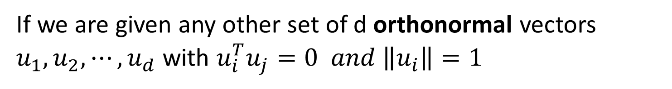

If we are given any other set of d orthonormal vectors $u_{1}, u_{2},⋯, u_{d}$ with $u_{i}^{T}u_{j}=0 and \left\|u_{i}\right\|=1$
We can re-express each point $x$ as the linear combination
$$x=a_{1}u_{1}+a_{2}u_{2}+⋯+a_{d}u_{d}$$
$$a={\left(a_{1},a_{2},…, a_{d}\right)}^{T} represents the coordinates of the x in the new basis.$$
The above combination can be represented as a matrix multiplication as well.
$$x=Ua$$
Where $U$ is the $d×d$ matrix, whose $i$-th column comprises the $i$-the basis vector $u_{i}$
$U=\left(\begin{matrix}| & | & & | \\ u_{1} & u_{2} & ⋯ & u_{d} \\ | & | & & |\end{matrix}\right)$

Slide 4
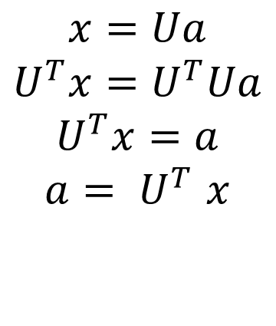




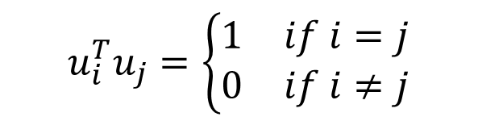
Where $U$ is an orthogonal matrix, where columns are orthonormal
$U=\left(\begin{matrix}| & | & & | \\ u_{1} & u_{2} & ⋯ & u_{d} \\ | & | & & |\end{matrix}\right)$
$$u_{i}^{T}u_{j}=\left\{\begin{aligned}\begin{matrix}1 & if i=j\end{matrix} \\ \begin{matrix}0 & if i≠j\end{matrix}\end{aligned}\right.$$
Since $U$ is an orthogonal matrix,
$$U^{−1}=U^{T}$$
$$U^{−1}=U^{T}→U^{T}U=I$$
$$x=Ua$$
$$U^{T}x=U^{T}Ua$$
$$U^{T}x=a$$
$$a{= U}^{T}x$$

Slide 5
Where $U$ is an orthogonal matrix, where columns are orthonormal
$U=\left(\begin{matrix}| & | & & | \\ u_{1} & u_{2} & ⋯ & u_{d} \\ | & | & & |\end{matrix}\right)$
$$u_{i}^{T}u_{j}=\left\{\begin{aligned}\begin{matrix}1 & if i=j\end{matrix} \\ \begin{matrix}0 & if i≠j\end{matrix}\end{aligned}\right.$$
Since $U$ is an orthogonal matrix,
$$U^{−1}=U^{T}$$
$$U^{−1}=U^{T}→U^{T}U=I$$
$$x=Ua$$
$$U^{T}x=U^{T}Ua$$
$$U^{T}x=a$$
$$a{= U}^{T}x$$

Slide 6

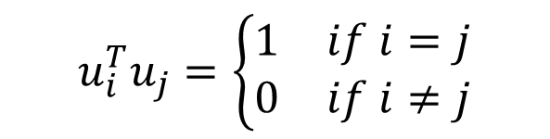

Let’s look at an example.
$$x={\left(−0.343, −0.754, 0.241\right)}^{T}$$
$e_{1}={\left(1, 0, 0\right)}^{T}$, $e_{2}={\left(0, 1, 0\right)}^{T}$, $e_{3}={\left(0, 0, 1\right)}^{T}$
$$u_{i}^{T}u_{j}=\left\{\begin{aligned}\begin{matrix}1 & if i=j\end{matrix} \\ \begin{matrix}0 & if i≠j\end{matrix}\end{aligned}\right.$$
New basis vectors
$u_{1}={\left(−0.390, 0.089, −0.916\right)}^{T}$, $u_{2}={\left(−0.639, −0.742, 0.200\right)}^{T}$, $u_{3}={\left(−0.663, 0.664, 0.346\right)}^{T}$
$${‖u}_{1}‖=\sqrt{{0.39}^{2}+{0.089}^{2}+{0.916}^{2}} ≈1$$
$$u_{1}^{T}u_{3}=−0.39∗−0.663+0.089∗0.664−0.916∗0.346≈0$$
$$a=U^{T}x=\left(\begin{matrix}−0.39 & 0.089 & −0.916 \\ −0.639 & −0.742 & 0.2 \\ −0.663 & 0.664 & 0.346\end{matrix}\right)\left(\begin{matrix}−0.343 \\ −0.754 \\ 0.241\end{matrix}\right)=\left(\begin{matrix}−0.154 \\ 0.828 \\ −0.190\end{matrix}\right)$$
$$x=−0.15u_{1}+0.828u_{2}−0.19u_{3}$$

Slide 7
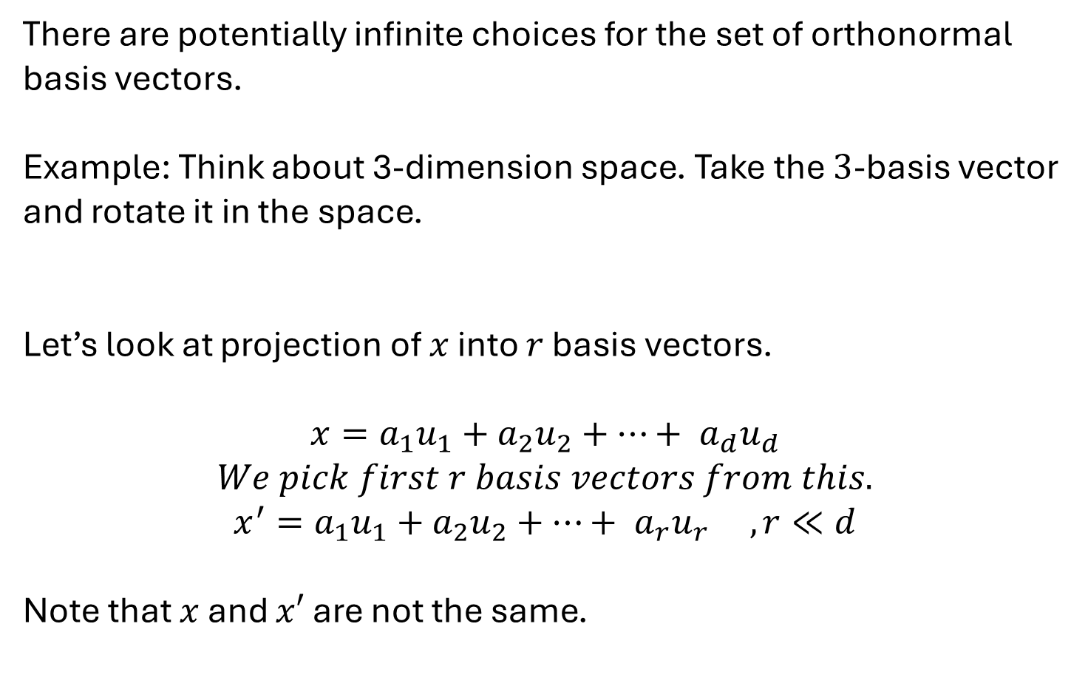
There are potentially infinite choices for the set of orthonormal basis vectors.
Example: Think about 3-dimension space. Take the $3$-basis vector and rotate it in the space.
Let’s look at projection of $x$ into $r$ basis vectors.
$$x=a_{1}u_{1}+a_{2}u_{2}+⋯+ a_{d}u_{d}$$
$$We pick first r basis vectors from this.$$
$$x^{′}=a_{1}u_{1}+a_{2}u_{2}+⋯+ a_{r}u_{r} , r≪d$$
Note that $x$ and $x′$ are not the same.

Slide 8
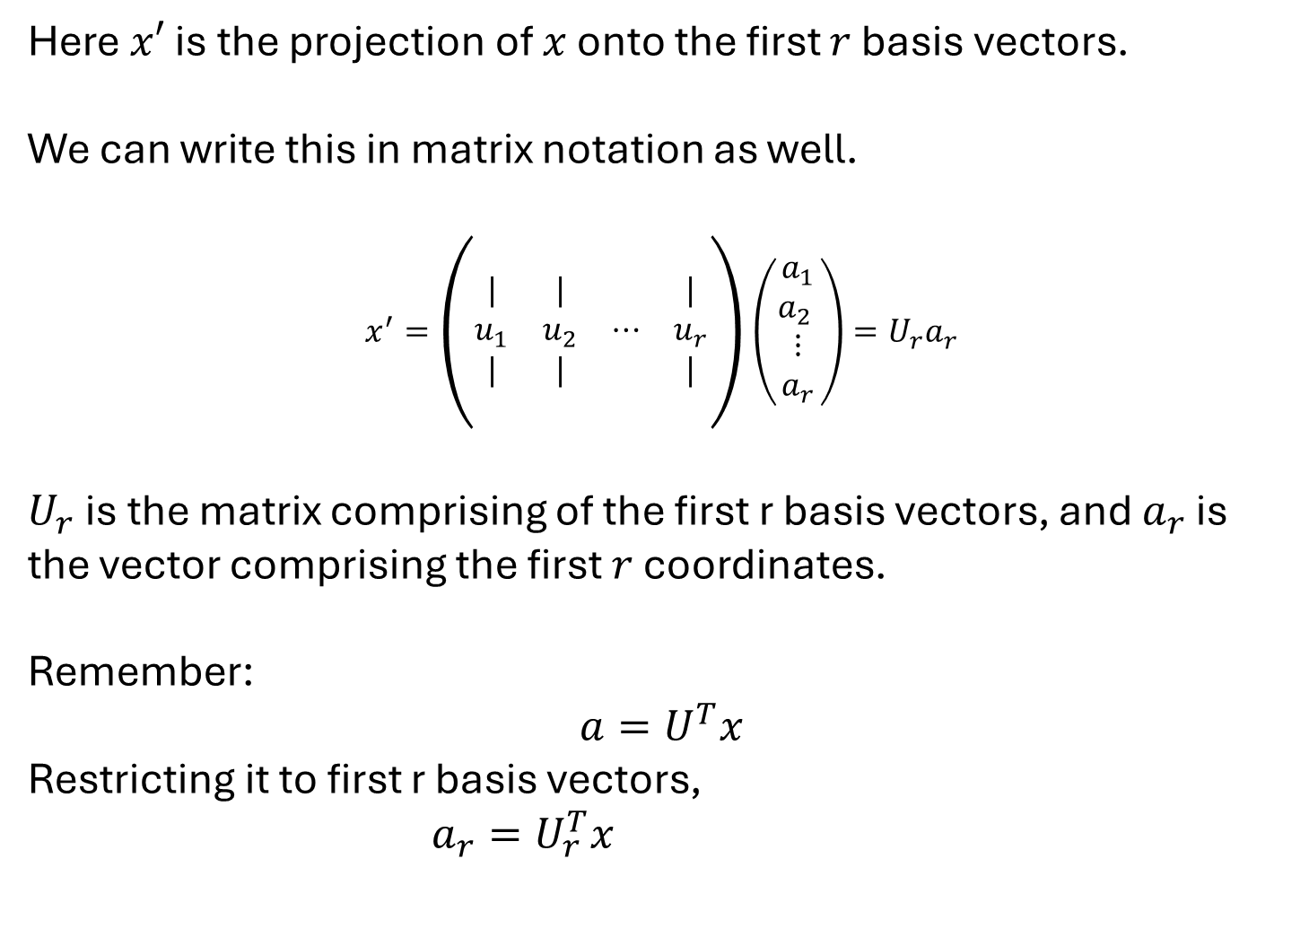
Here $x′$ is the projection of $x$ onto the first $r$ basis vectors.
We can write this in matrix notation as well.
$$x^{′}=\left(\begin{matrix}| & | & & | \\ u_{1} & u_{2} & ⋯ & u_{r} \\ | & | & & |\end{matrix}\right)\left(\begin{matrix}\begin{matrix}a_{1} \\ a_{2} \end{matrix} \\ \begin{matrix}⋮ \\ a_{r}\end{matrix}\end{matrix}\right)=U_{r}a_{r}$$
$U_{r}$ is the matrix comprising of the first r basis vectors, and $a_{r}$ is the vector comprising the first $r$ coordinates.
Remember:
$$a=U^{T}x$$
Restricting it to first r basis vectors,
$a_{r}=U_{r}^{T}x$

Slide 9
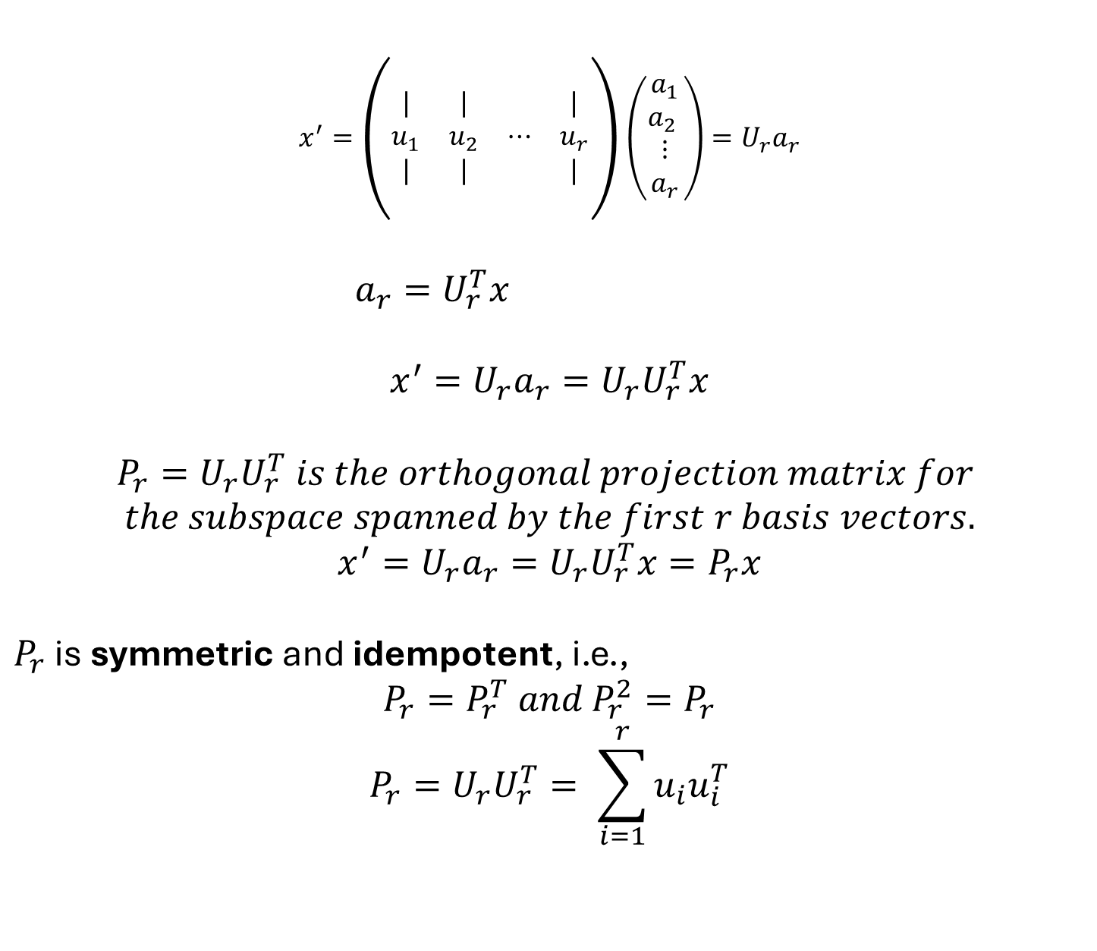
$$x^{′}=\left(\begin{matrix}| & | & & | \\ u_{1} & u_{2} & ⋯ & u_{r} \\ | & | & & |\end{matrix}\right)\left(\begin{matrix}\begin{matrix}a_{1} \\ a_{2} \end{matrix} \\ \begin{matrix}⋮ \\ a_{r}\end{matrix}\end{matrix}\right)=U_{r}a_{r}$$
$a_{r}=U_{r}^{T}x$
$$x^{′}=U_{r}a_{r}=U_{r}U_{r}^{T}x$$
$$P_{r}=U_{r}U_{r}^{T} is the orthogonal projection matrix for$$
$$the subspace spanned by the first r basis vectors.$$
$$x^{′}=U_{r}a_{r}=U_{r}U_{r}^{T}x=P_{r}x$$
$P_{r}$ is symmetric and idempotent, i.e.,
$$P_{r}=P_{r}^{T} and P_{r}^{2}=P_{r}$$
$$P_{r}=U_{r}U_{r}^{T}= \sum_{i=1}^{r}{u_{i}u_{i}^{T}}$$

Slide 10
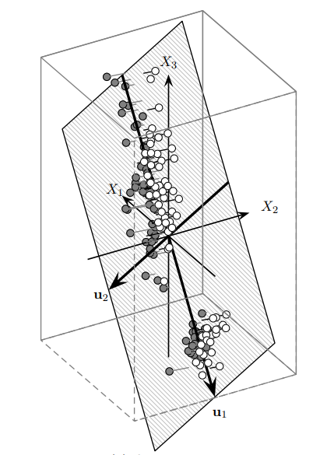

$$ε=\sum_{i=r+1}^{d}{a_{i}u_{i}}=x −x^{′}$$
We can get an expression for the error of the projection.

Slide 11

$$ε=\sum_{i=r+1}^{d}{a_{i}u_{i}}=x −x^{′}$$
We can get an expression for the error of the projection.
Note that $x^{′}$ and $ε$ are orthogonal vectors.

Slide 12
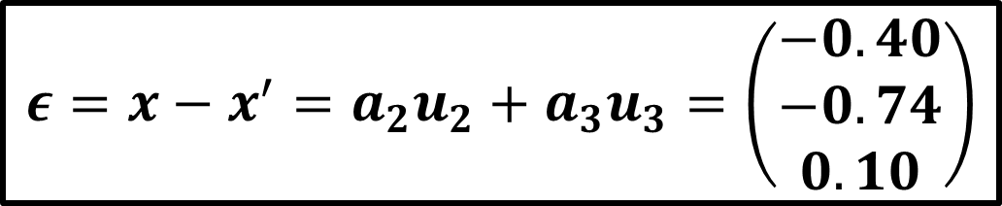
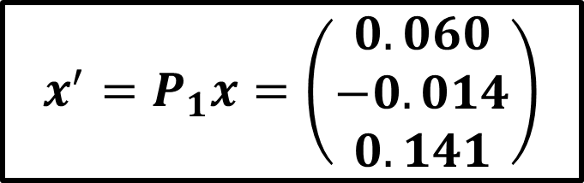

Let’s look at an example.
$$x={\left(−0.343, −0.754, 0.241\right)}^{T}$$
$e_{1}={\left(1, 0, 0\right)}^{T}$, $e_{2}={\left(0, 1, 0\right)}^{T}$, $e_{3}={\left(0, 0, 1\right)}^{T}$
New basis vectors
$u_{1}={\left(−0.390, 0.089, −0.916\right)}^{T}$, $u_{2}={\left(−0.639, −0.742, 0.200\right)}^{T}$, $u_{3}={\left(−0.663, 0.664, 0.346\right)}^{T}$
Let’s pick only one new basis $u_{1}$ vector and project the data.
$$P_{1}=u_{1}u_{1}^{T}=\left(\begin{matrix}−0.39 \\ 0.089 \\ −0.916\end{matrix}\right)\left(\begin{matrix}−0.39 & 0.089 & −0.916\end{matrix}\right)$$
$$=\left(\begin{matrix}0.152 & −0.035 & 0.357 \\ −0.035 & 0.008 & −0.082 \\ 0.357 & −0.082 & 0.839\end{matrix}\right)$$
$$x^{′}=P_{1}x=\left(\begin{matrix}0.060 \\ −0.014 \\ 0.141\end{matrix}\right)$$
$$ε=x−x^{′}=a_{2}u_{2}+a_{3}u_{3}=\left(\begin{matrix}−0.40 \\ −0.74 \\ 0.10\end{matrix}\right)$$

Slide 13
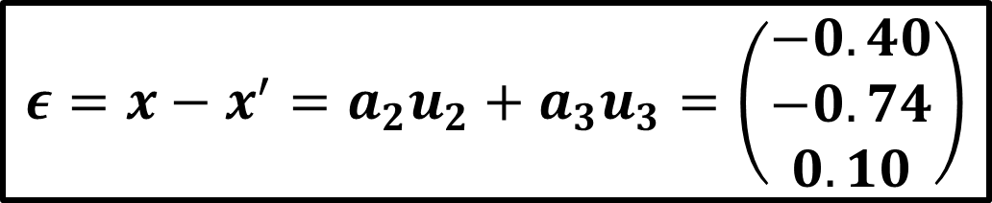
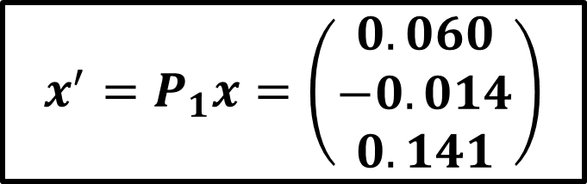

Let’s look at an example.
$$x^{′}=P_{1}x=\left(\begin{matrix}0.060 \\ −0.014 \\ 0.141\end{matrix}\right)$$
$$ε=x−x^{′}=a_{2}u_{2}+a_{3}u_{3}=\left(\begin{matrix}−0.40 \\ −0.74 \\ 0.10\end{matrix}\right)$$
We can check that $x′$ and $ε$ are orthogonal.
$$x^{′T}e=\left(\begin{matrix}0.06 & −0.014 & 0.141\end{matrix}\right)\left(\begin{matrix}−0.40 \\ −0.74 \\ 0.10\end{matrix}\right)=0$$

Slide 14
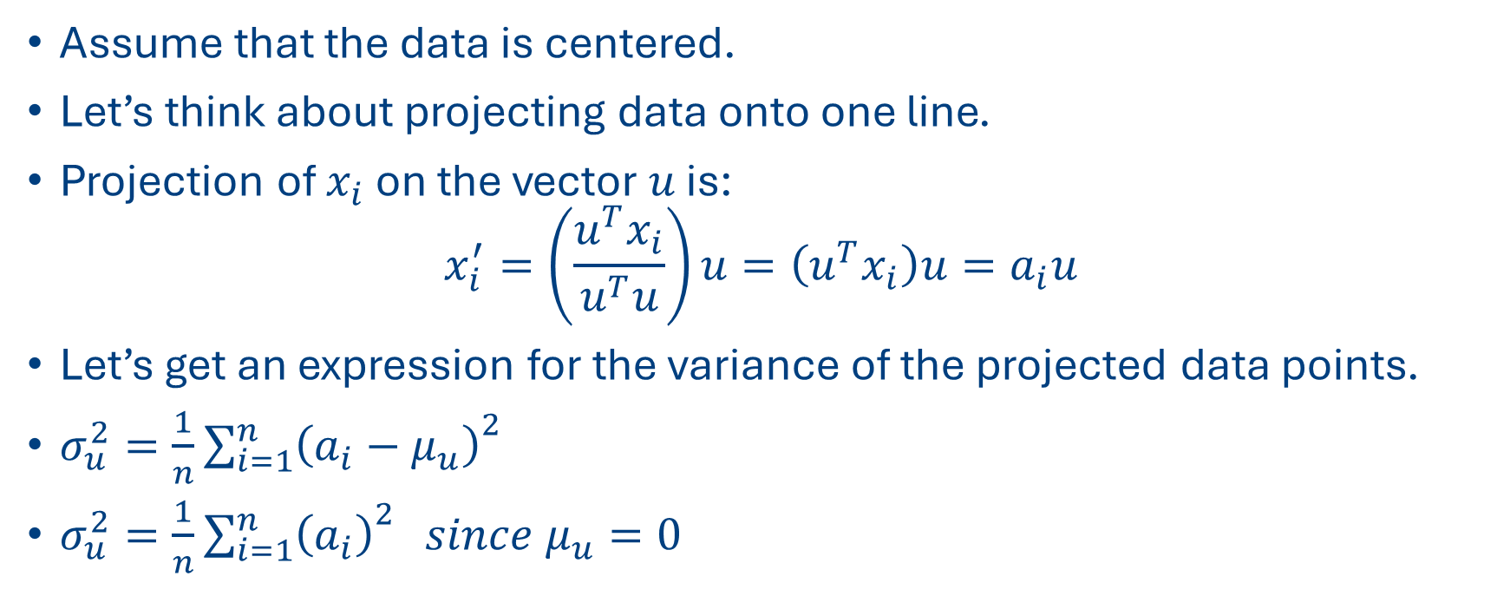
Proof of PCA
Assume that the data is centered.
Let’s think about projecting data onto one line.
Projection of $x_{i}$ on the vector $u$ is:
$$x_{i}^{′}=\left(\frac{u^{T}x_{i}}{u^{T}u}\right)u=\left(u^{T}x_{i}\right)u=a_{i}u$$
Let’s get an expression for the variance of the projected data points.
$σ_{u}^{2}=\frac{1}{n}{\sum_{i=1}^{n}{\left(a_{i}−μ_{u}\right)}}^{2}$
$σ_{u}^{2}=\frac{1}{n}{\sum_{i=1}^{n}{\left(a_{i}\right)}}^{2} since μ_{u}=0$

Slide 15
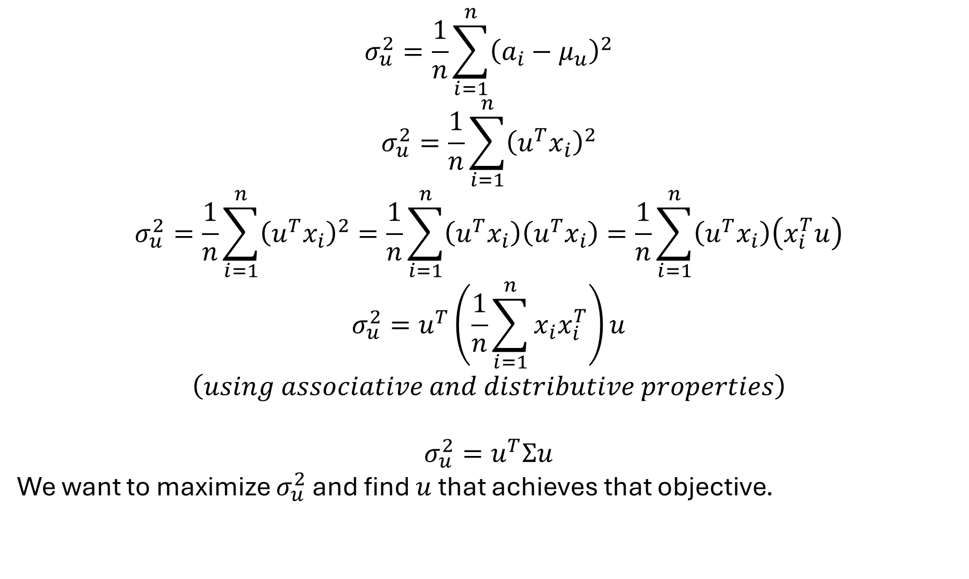
$$σ_{u}^{2}=\frac{1}{n}\sum_{i=1}^{n}{{\left(a_{i}−μ_{u}\right)}^{2}}$$
$$σ_{u}^{2}=\frac{1}{n}\sum_{i=1}^{n}{{\left(u^{T}x_{i}\right)}^{2}}$$
$$σ_{u}^{2}=\frac{1}{n}\sum_{i=1}^{n}{{\left(u^{T}x_{i}\right)}^{2}}=\frac{1}{n}\sum_{i=1}^{n}{\left(u^{T}x_{i}\right)\left(u^{T}x_{i}\right)}=\frac{1}{n}\sum_{i=1}^{n}{\left(u^{T}x_{i}\right)\left(x_{i}^{T}u\right)}$$
$$σ_{u}^{2}=u^{T}\left(\frac{1}{n}\sum_{i=1}^{n}{x_{i}x_{i}^{T}}\right)u$$
$$\left(using associative and distributive properties\right)$$
$$σ_{u}^{2}=u^{T}Σu$$
We want to maximize $σ_{u}^{2}$ and find $u$ that achieves that objective.
Notes:
Associative and distributive properties

Slide 16
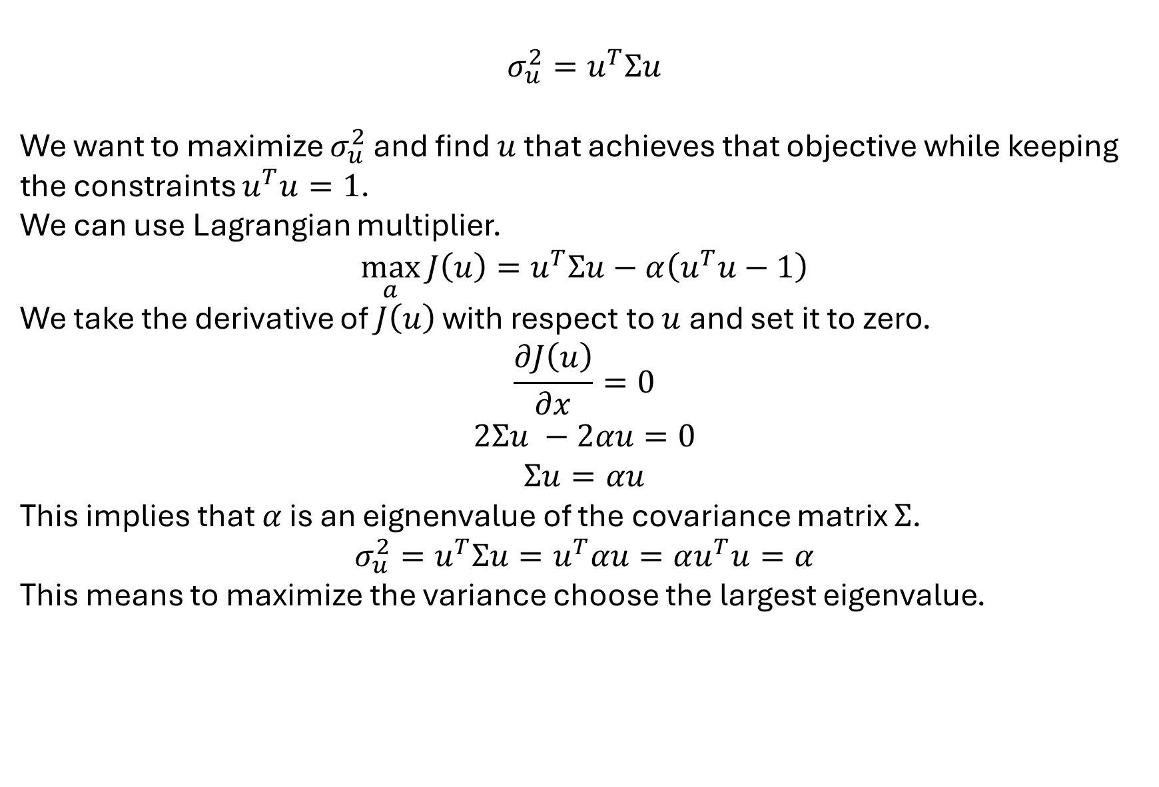
$$σ_{u}^{2}=u^{T}Σu$$
We want to maximize $σ_{u}^{2}$ and find $u$ that achieves that objective while keeping the constraints $u^{T}u=1$.
We can use Lagrangian multiplier.
$$\max_{a}{J\left(u\right)=u^{T}Σu−α\left(u^{T}u−1\right)}$$
We take the derivative of $J\left(u\right)$ with respect to $u$ and set it to zero.
$$\frac{∂J\left(u\right)}{∂x}=0$$
$$2Σu −2αu=0$$
$$Σu=αu$$
This implies that $α$ is an eignenvalue of the covariance matrix $Σ$.
$$σ_{u}^{2}=u^{T}Σu=u^{T}αu=αu^{T}u=α$$
This means to maximize the variance choose the largest eigenvalue.

